Slide 1
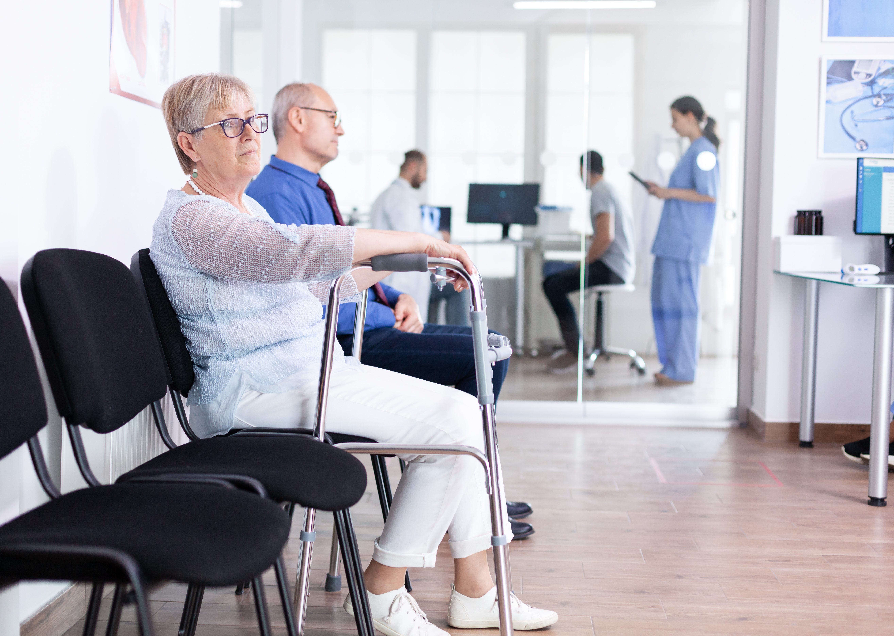
LENGTH OF-STAY PREDICTION AT TIME OF ADMISSION

Slide 2
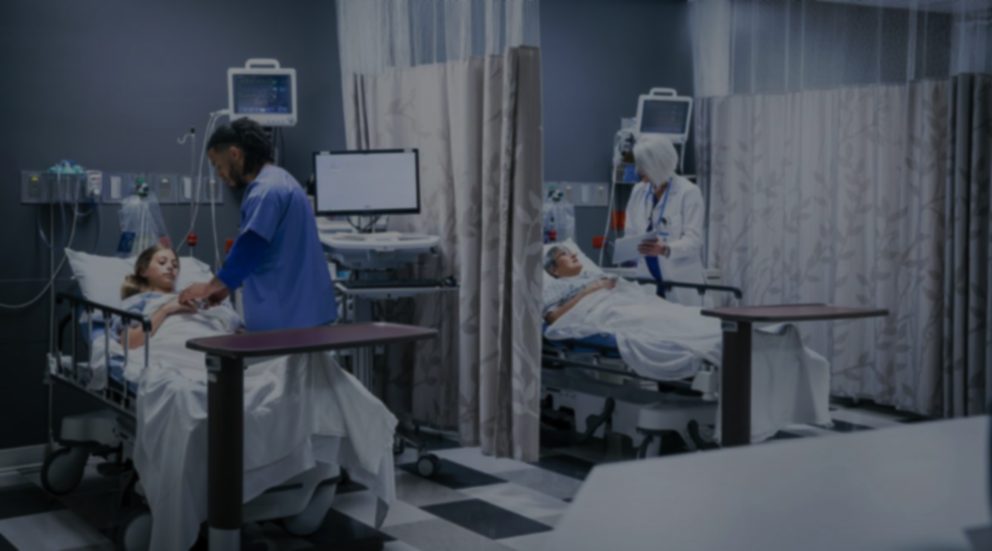
Canada has a relatively short supply of doctors and hospital beds—and the longest wait times, despite spending more on health care than most other developed countries with universal coverage
-- Fraser Institute (Comparing Performance of Universal Health Care Countries, 2019)

Slide 3
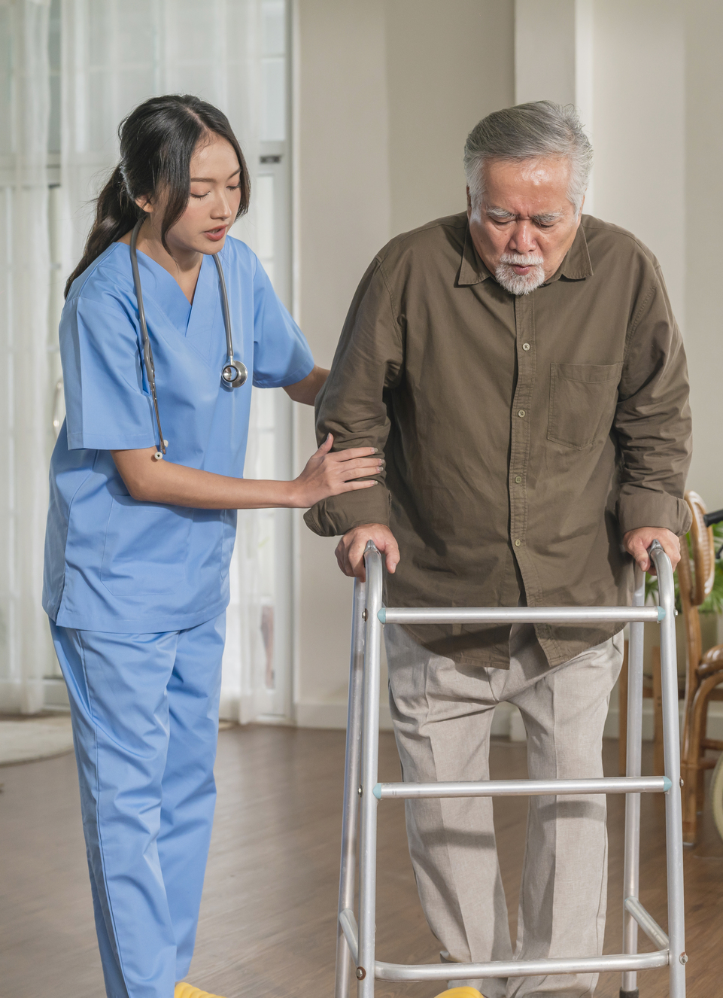
PROJECT MOTIVATION
The problem of long wait times is growing bigger, as Canada’s senior population grows in number with each passing day, seeking more medical care.
As suggested by Canadian Institute of Health Information (CIHI), Over the next 20 years, Canada’s seniors’ population — those age 65 and older — is expected to grow by 68%.

Slide 4

BACKGROUND
For this project, we have chosen to focus on hospital Length-Of-Stay (LOS), which is a very crucial aspect of determining the wait times and beds availability in the hospitals.
Length-Of-Stay (LOS) is defined as the period of time, expressed in days, between hospital admission time and discharge time.

Slide 5



WHY LENGTH OF STAY (LOS)?
Improve Communication
An accurate prediction of a patient's remaining LOS would be a useful guide for expectation management and would improve communication between doctors and their patients.
Improve Resource Allocation
Precise LOS prediction of patients is critical for efficient use of resources such as staff, ventilators, and other medical devices, especially in ICU.
Improve Service Quality
Better resource allocation can improve the quality of healthcare services for patients (for example, on-time diagnosis, shorter wait times etc.) while reducing costs.

Slide 6


GOAL OF THE PROJECT
Exploratory Data Analysis
Impact of factors, such as, patient age, gender, race, ethnicity, admission type, diagnosis category (heart disease, delivery, injury/poisoning, etc.) on a patient’s LOS.
Predictive Analytics
We will be further using these factors to develop a predictive ML model to predict the LOS of future patients, that the hospitals can utilize to optimize their medical resources and better manage bed availability in the emergency wards.

Slide 7

DATASET: MIMIC-III CLINICAL
For this project, we will be using the MIMIC-III Clinical dataset, which is a large, freely-available database comprising deidentified health-related data associated with over 40,000 patients who stayed in critical care units of the Beth Israel Deaconess Medical Center between 2001 and 2012.
This is a relational database consisting of 26 tables, that strongly simulates real life databases that are used in modern day hospitals.

Slide 8
DATA PRE-PROCESSING

Slide 9










DATA PRE-PROCESSING PIPELINE
UNDERSTANDING DATA
Research Articles
DATA CLEANING
Missing Data
Outlier Analysis
Binning
DATA INTEGRATION
Joining and Merging Tables
ADMISSIONS DATA
PATIENTS DATA
ICU STAYS DATA
DIAGNOSES (ICD 9) DATA
DATA QUALITY ASSESSMENT
Mismatched data types
Mixed data values
DATA TRANSFORMATION
Encoding Categorical Features
Feature Engineering
DATA VISUALIZATION
EDA in Tableau

Slide 10
EXPLORATORY DATA ANALYSIS

Slide 11
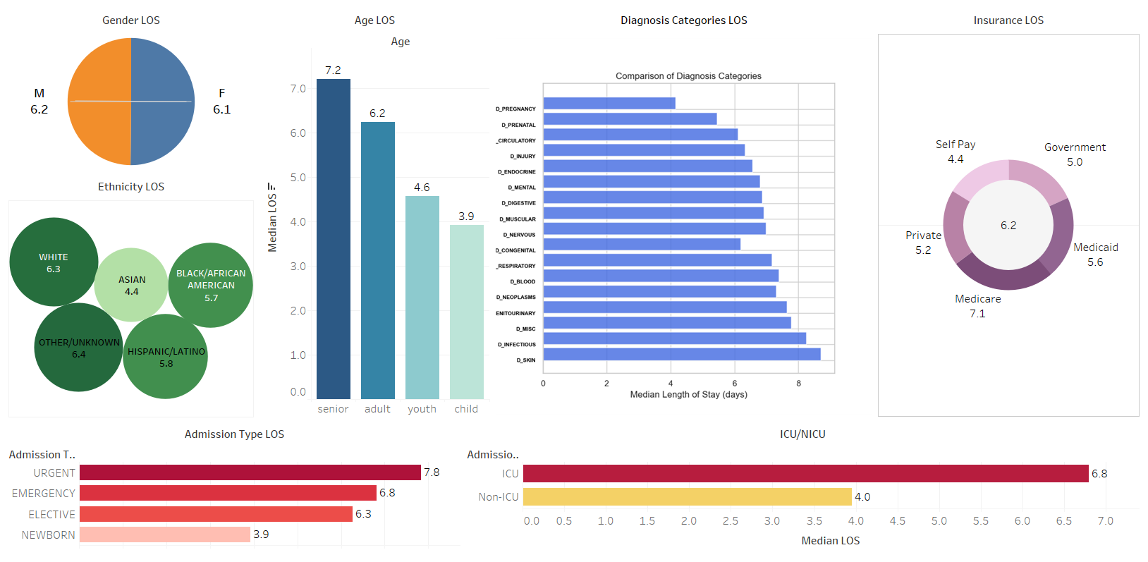
EXPLORATORY DATA ANALYSIS

Slide 12
ML MODEL IMPLEMENTATION

Slide 13
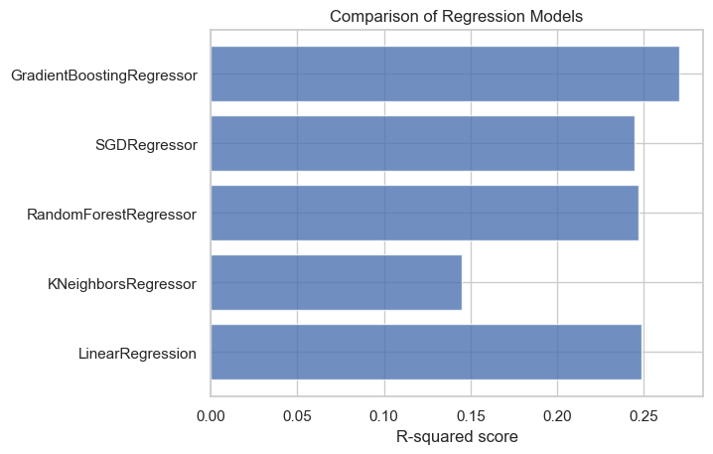
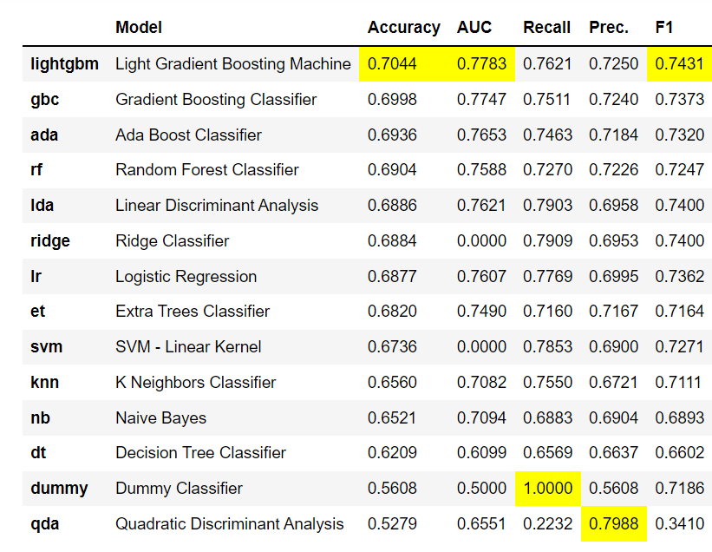
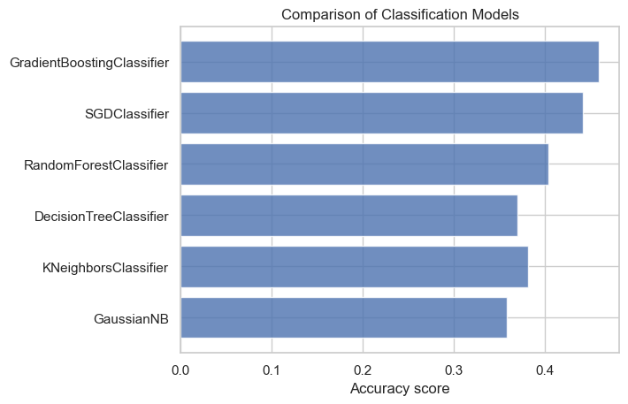
MODEL IMPLEMENTATION
Regression (Baseline)
Binary Classification (Using Auto-ML)
Multiclass Classification (Baseline)

Slide 14
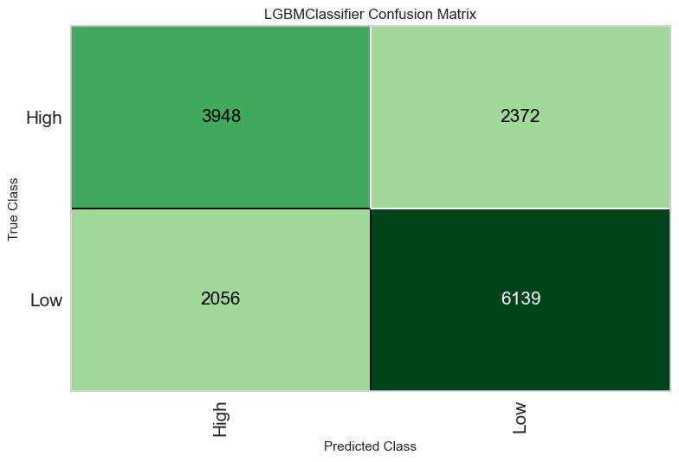
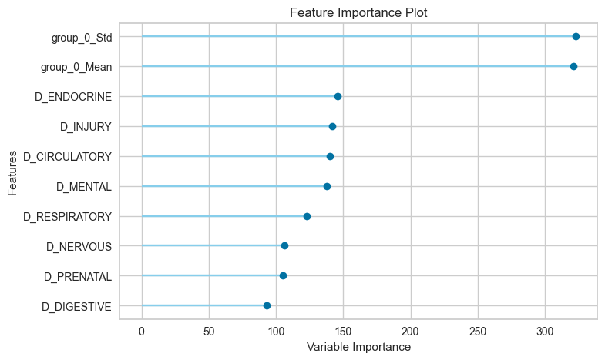
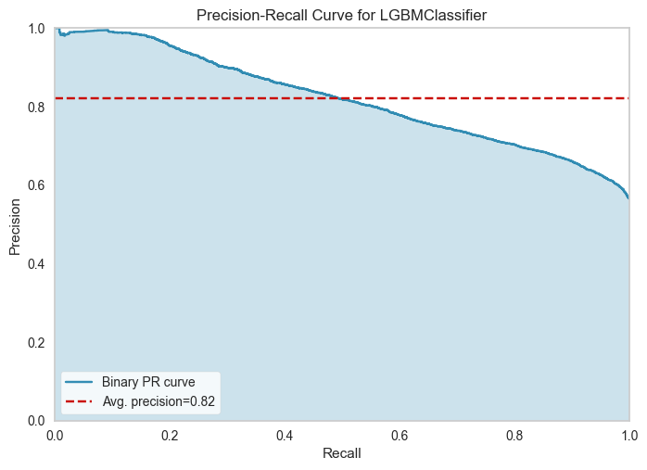
MODEL PERFORMANCE
Confusion Matrix
Feature Importance
Precision Recall Curve

Slide 15
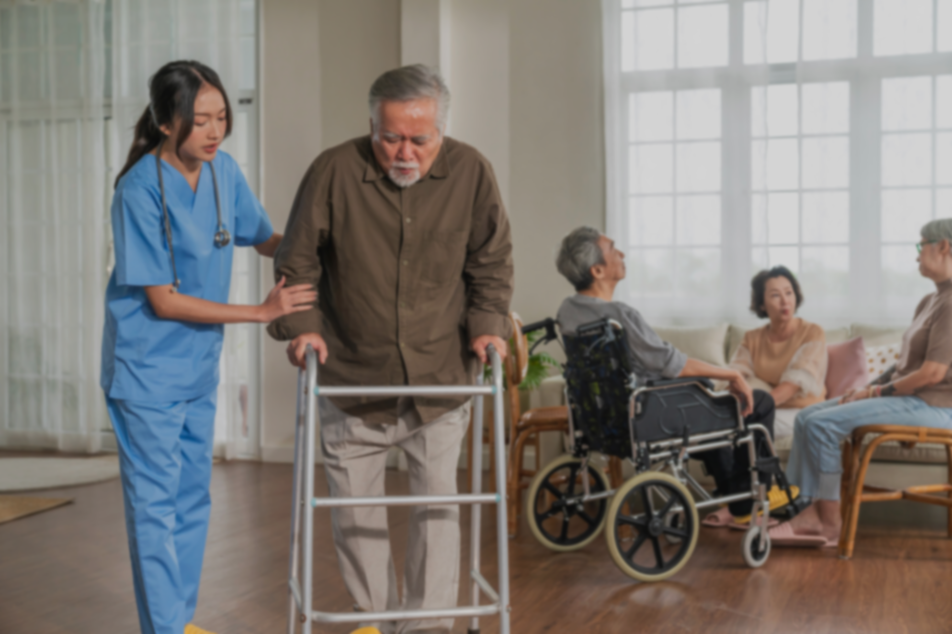
WAY FORWARD

Slide 16
Thank You!
Siddhartha Patra (0787887)
Usama Norat (079225)

Slide 17
REFERENCES
MIMIC-III Clinical Database
Charles, D., King, J., Patel, V. & Furukawa, M. Adoption of Electronic Health record Systems among U.S. Non-federal Acute Care Hospitals. ONC Data Brief No. 9, 1–9 (2013).
Collins, F. S. & Tabak, L. A. NIH plans to enhance reproducibility. Nature 505, 612–613 (2014).
Waiting Your Turn: Wait Times for Health Care in Canada, 2021 (The Fraser Institute)
Comparing Performance of Universal Health Care Countries, 2019 (The Fraser Institute)
Canada’s seniors population outlook (Canadian Institute of Health Information)
Special thanks to all the people who made and released these great resources for free:
Presentation template by SlidesCarnival
Photographs by Unsplash
Icons by Flaticon

